Slide 1
Use case
Best trap (prospect) to drill based on reservoir potential (Submarine fan), trap consistency (fault-dependent traps) and migration-accummulation potential

Slide 2
STEP 1
Evaluation of hydrocarbon migration-accumulation inside each trap, assuming perfect reservoir rock
(has good lateral continuity, porosity and permeability) and perfect seal rock (using RL).
What we know:
R2 is the reservoir rock (sandstone) (RR).
R3 is the Source rock (SR) and top seal (shale).
R1 is the lateral seal(shale).
Source Rock has generated and expulsed hydrocarbons.
Traps are fault-dependent.
Migration (secondary) directly from the SR into the RR and then laterally through the RR (fill-spill migration).
What we do not know:
If the faults F1, F2, F3 and F4 are sealing or non-sealing.
Question to answer:
What are the traps in which hydrocarbons will accumulate
by changing sealing capacity of the faults.
Trap4
F3
R1
F2
Trap3
F4
F1
Trap2
Trap1
SR

Slide 3
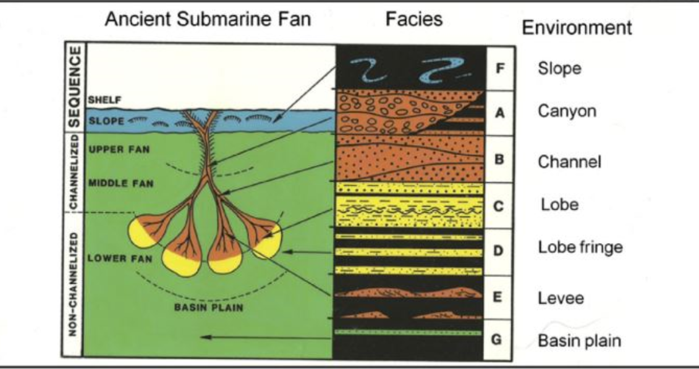
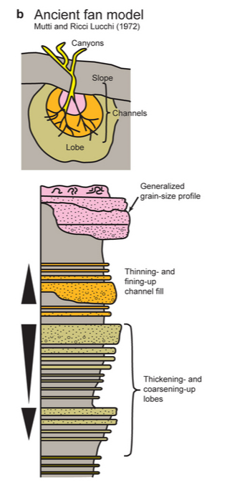
STEP 2
Evaluation of the reservoir distribution and quality assuming depositional environment Submarine Fan (using FOL and ontology).
Proximal
Distal
(after Mutti and Ricci Lucchi, 1072)

Slide 4

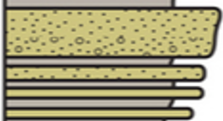


STEP 3
How reservoir distribution and quality can affect
the migration-accumulation process inside a trap –
connection with the RL
Middle fan;
Channels and
overbank
Trap4
Lobe
R1
F3
Lower fan:
Proximal
Trap3
F4
F2
F1
Lobe fringe
Distal

Slide 5
STEP 2
Submarine fan – reservoir distribution and characterization
Describing the reservoir distribution in each components of the submarine fan system (from proximal to distal), facies specific and facies association
  Upper fan
    Feder channel(s)
  Middle fan
  Distributary channels and interchannel settings
  Lower fan
    Lobe complexes
      Lobe -faciesC
      Lobe fringe
  Basin plain
    hemipelagites
Reservoir characterizarion from quality point of view :
    Porosity
    Permeability
    Lateral continuity
    Vertical conectivity
      Examples:
        Good porosity inside the lobe
        Porosity increases from proximal to distal; permeability decreases form proximal to distal.
Determine in which part of the submarine fan our traps are located based on specific features seen on well logs, seismic:
  Bed thickness trend:
    Thinning upwards – specific for channel
  Grain size trend:
    Coaesening upward –specific for lobe
  Channel base type
  Presence or absence of levee
Sediment transport processes
  Turbidity currents – high/low density
Source of sediments

Slide 6
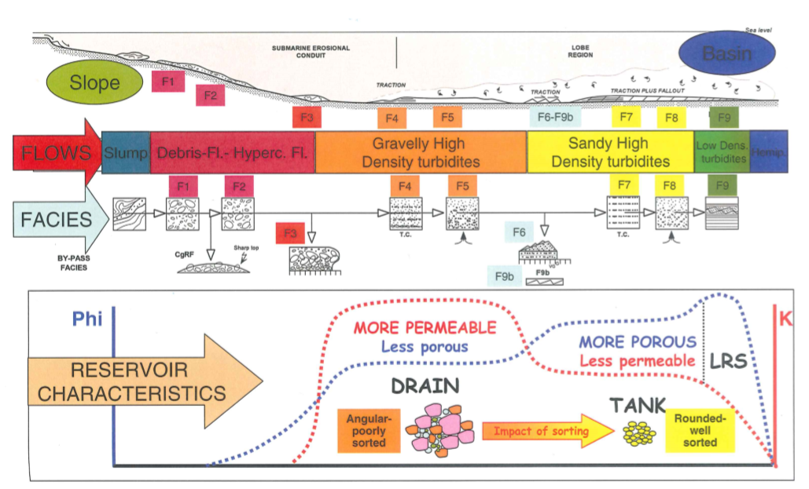
Mutti’s facies classification and reservoir potential

Slide 7
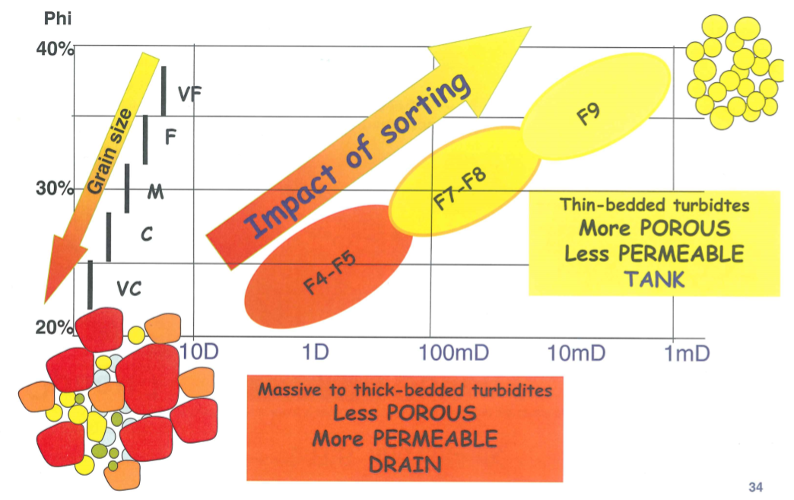
Mutti’s facies classification and reservoir potential

Slide 8
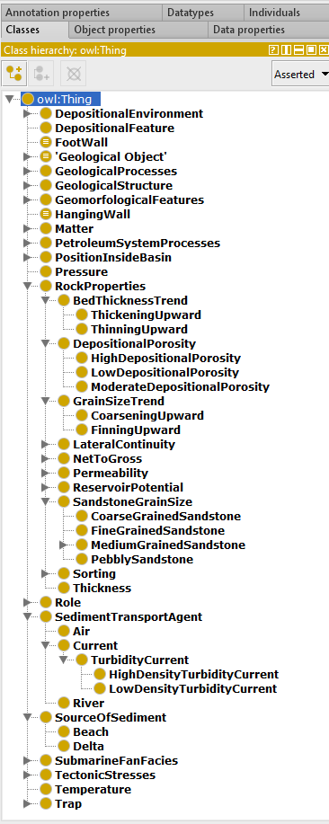
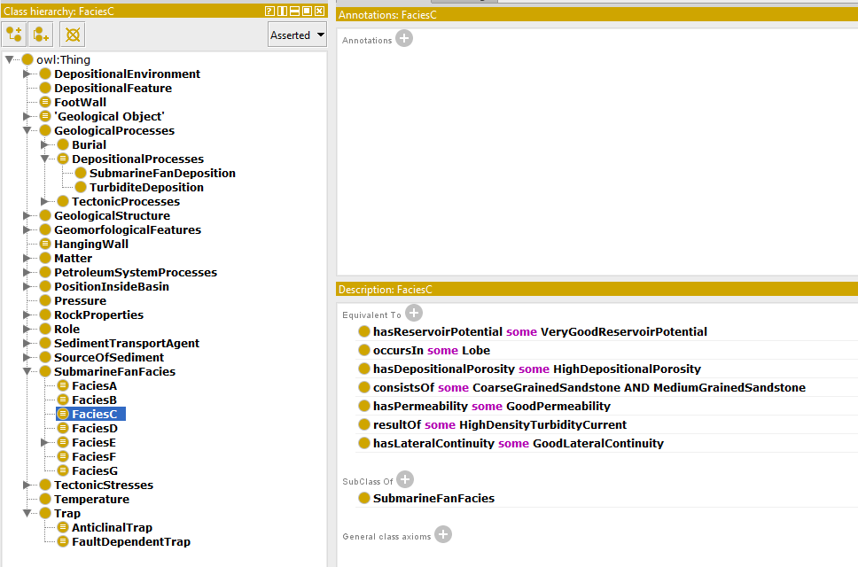
STEP 2
Facies characterization using ontology (example)

Slide 9
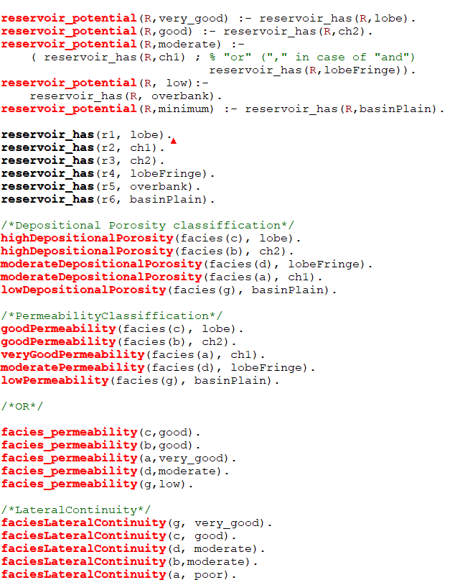
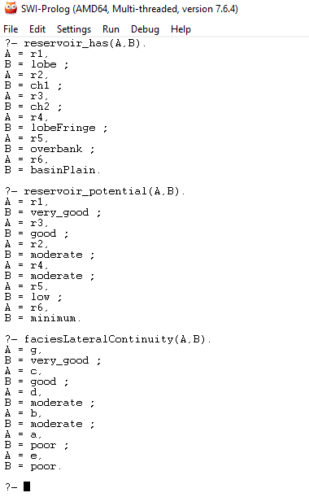
STEP 2
Facies characterization using FOL (example)

